Slide 1


USA YouTube Trend Findings:
Blackpink Branding & Marketing Strategies by Lucia Zhang

Slide 2
Summary:
YouTube sees the highest usage among social media platforms by video marketers, more than TikTok and Instagram. It is also where marketers will invest the most in this year.
This exploratory data analysis aims to find out:
Does it matter what time you post on YouTube?
Measure and Identify trend, opportunities and possibilities:
the most viewed categories, which one will be the next to shine
Analyze and determine the main possible causes of variation:
why Blackpink so successful, Matthew effect with social influence?
Find and verify: the striking branding & the most optimal marketing strategies
If your social media strategy is 100% proactive, knowing the audience and platform insights will set you up for long-term business success.

Slide 3
Overview: The Project Process
Methodologies: Waterfall & Agile
Define and Measure
Clean data, Measure process output Y, Find outlier:
Analyze main causes of variation
What time is the best to upload video, what time to avoid ?
Is the most liked/viewed video also the most long-lasting trending video?
Find and Verify the most optimal solution
The Rule of Three, Matthew Effect on YouTube: a market with social influence
Find and verify:branding & the most optimal marketing strategies

Slide 4
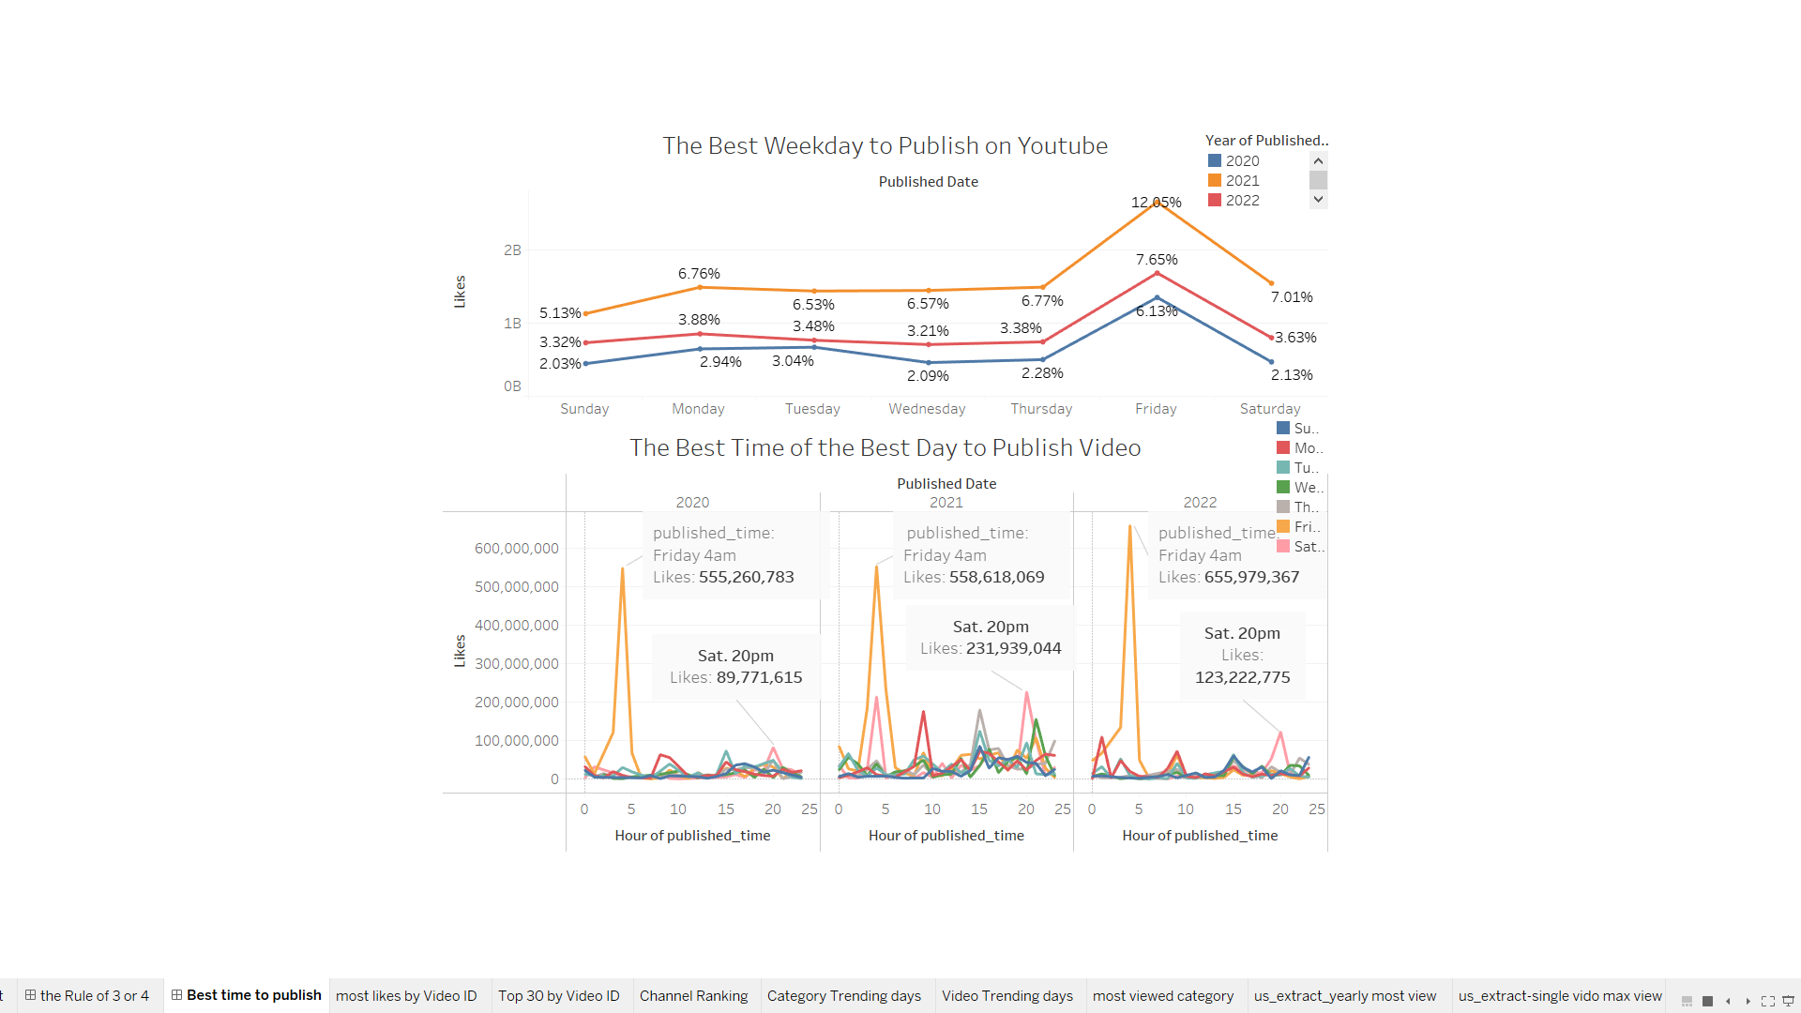
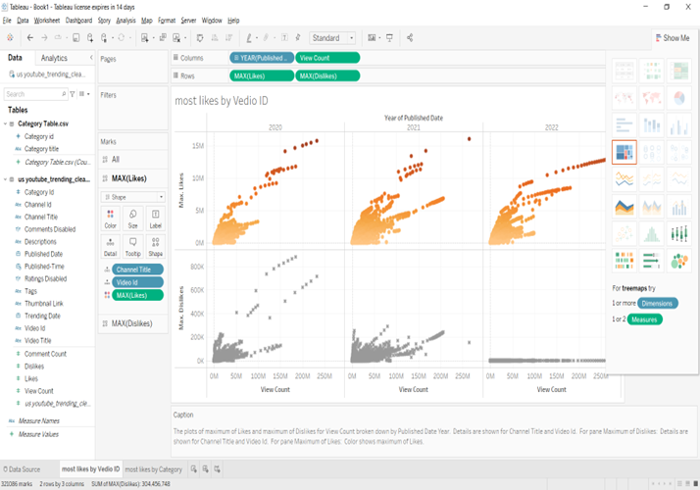
Findings: Outliers
* AVG(likes): 137,316.4; STDV(likes): 423,072.75 *Max. likes: 16,021,534; Max. dislikes : 879,354
* Max view count: 277,791,741
Total Unique Channel-Id:6,634, Video-Id: 30,985

Slide 5
Findings: The Best Time to Upload Video
Day most effective: Thur., Fri & Sat Hour: *Best Fri @4am,in early morning people are catching newsfeeds
*near weekend users more active online *Noon to 15pm is great: the biggest gap during lunch time
more likely to watch videos. *17~20 pm not bad,checking out what missed over the day

Slide 6
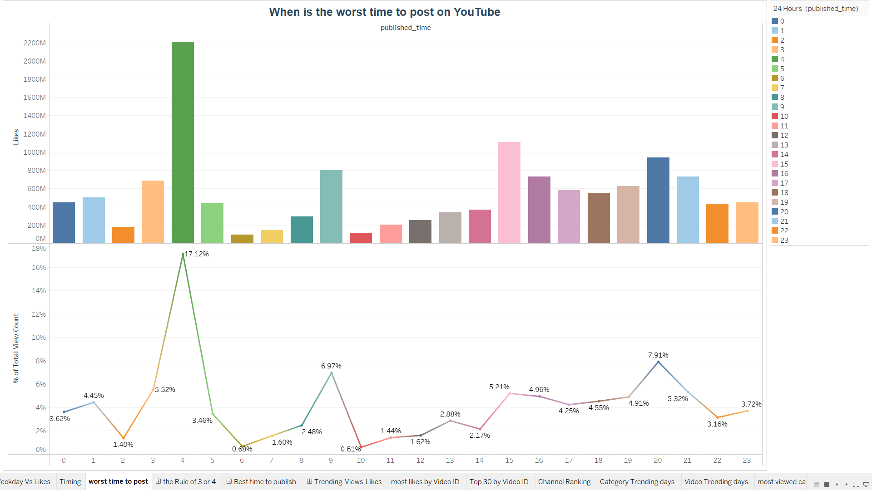
Findings: The Time to Avoid
Day: Monday, Tue. & Wed. Hour: *0~2am
* 5-6am, 10am
more likely to watch videos. *17~20pm not bad,checking out what missed over the day

Slide 7
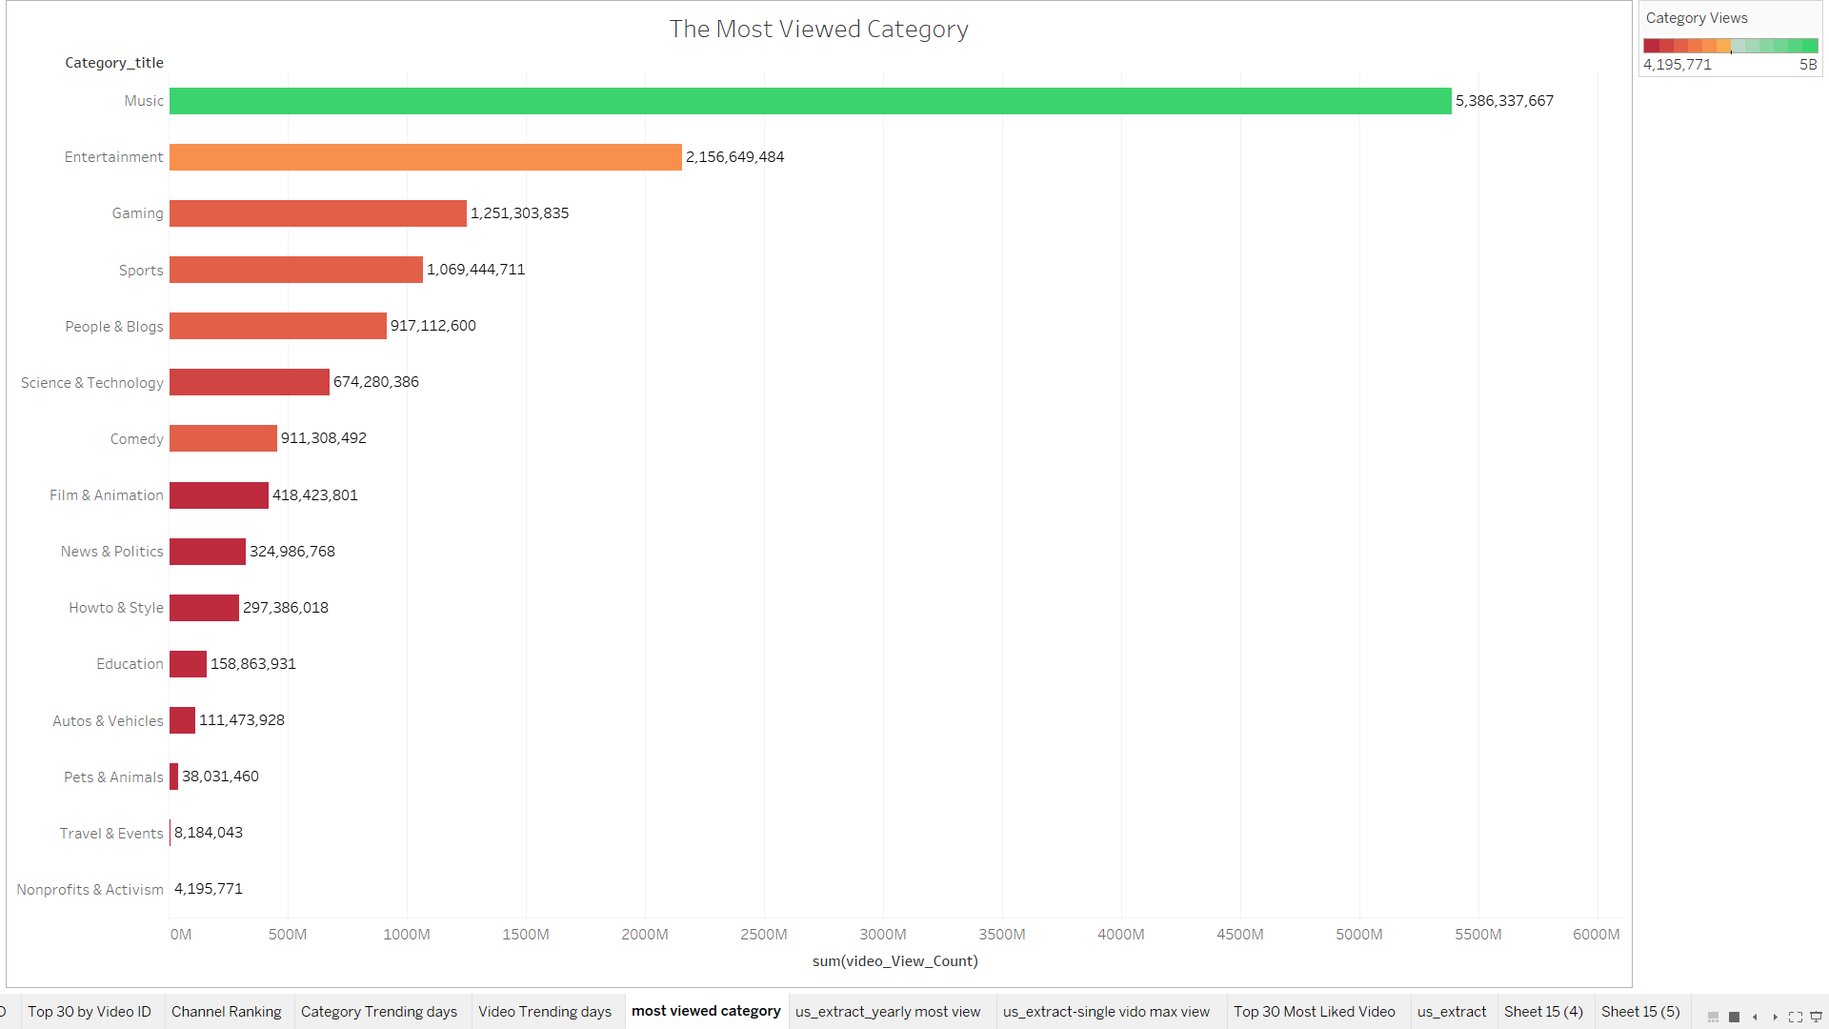
Findings
The Most Viewed Categories
In US, the most viewed videos are in Music, Entertainment, Gaming and Sports categories
People mainly take YouTube as leisure platform.
Popular videos are designed to entertain, educate and/or inspire the audience.
Videos like Trailers made purely to sell do not engage viewers very well.

Slide 8
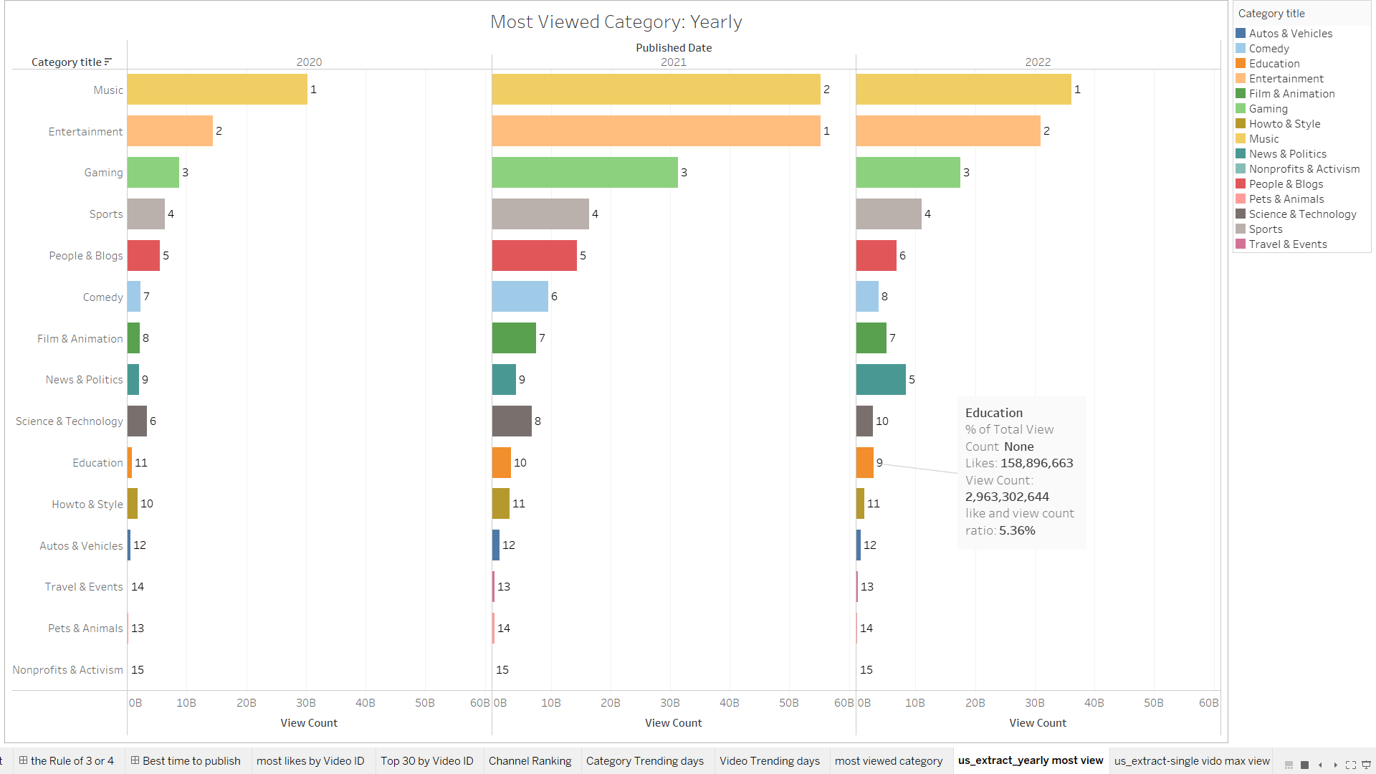
Findings:
The Trend of Most Viewed Categories
*Music, Entertainment, Gaming, Sports remain the big 4.
Education: the next to shine
* Up to No 9 from 11.
*View count quadrupled in 2021; Oct 2022: 50% higher than 2021
*The likes/view_count ratio:5.36%, > No. 2 Entertainment 4.63%, close to Gaming 5.39%

Slide 9
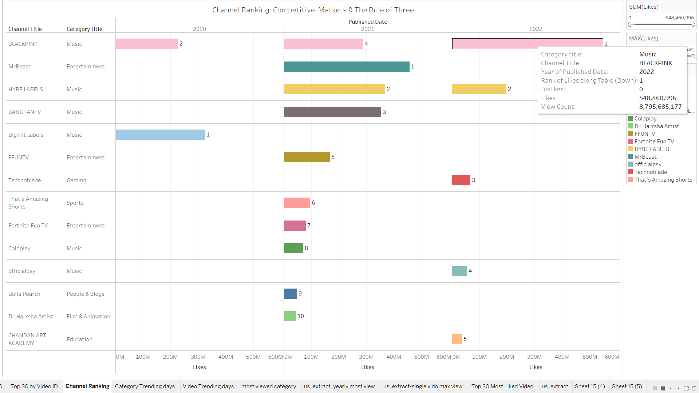
Findings:
Top 10 Performing Channels: Most Viewed & Liked
*Top 3 performing channels are in the most viewed/liked categories: Music, Entertainment, Gaming
*Blackpink: the record breaking likes and views: 8B: 5 times of No.2, 15 times of No.3
*A Education channel in Top 5 for the first time
*The Rule of Three: The fight BTW No. 1 & No. 2 often sends the No. 3 into the ditch, a new No. 3 full-line player always emerges

Slide 10
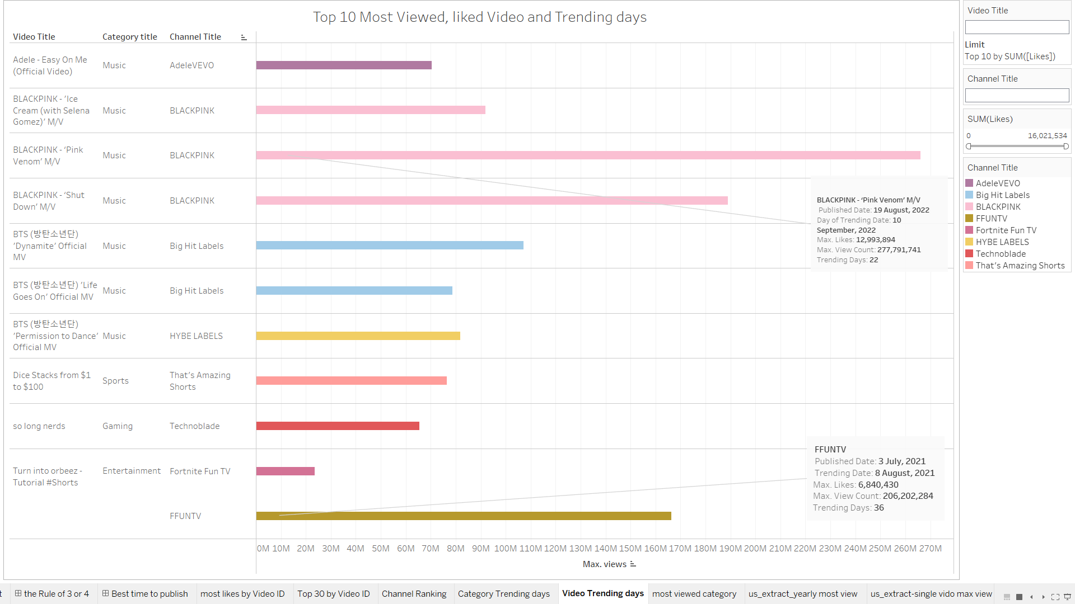
Findings
Is the most liked, viewed video also the most long-lasting trending video?
*Pink Venom: 12 million likes & 277 million views, recorder maker: on trending: 22 days
* Shut Down: much less view counts and likes: 29 days
*206M views & 6M likes, FFUNTV on trending list 36 days
*Trending considers many signals, some trends are predictable, others are surprising

Slide 11
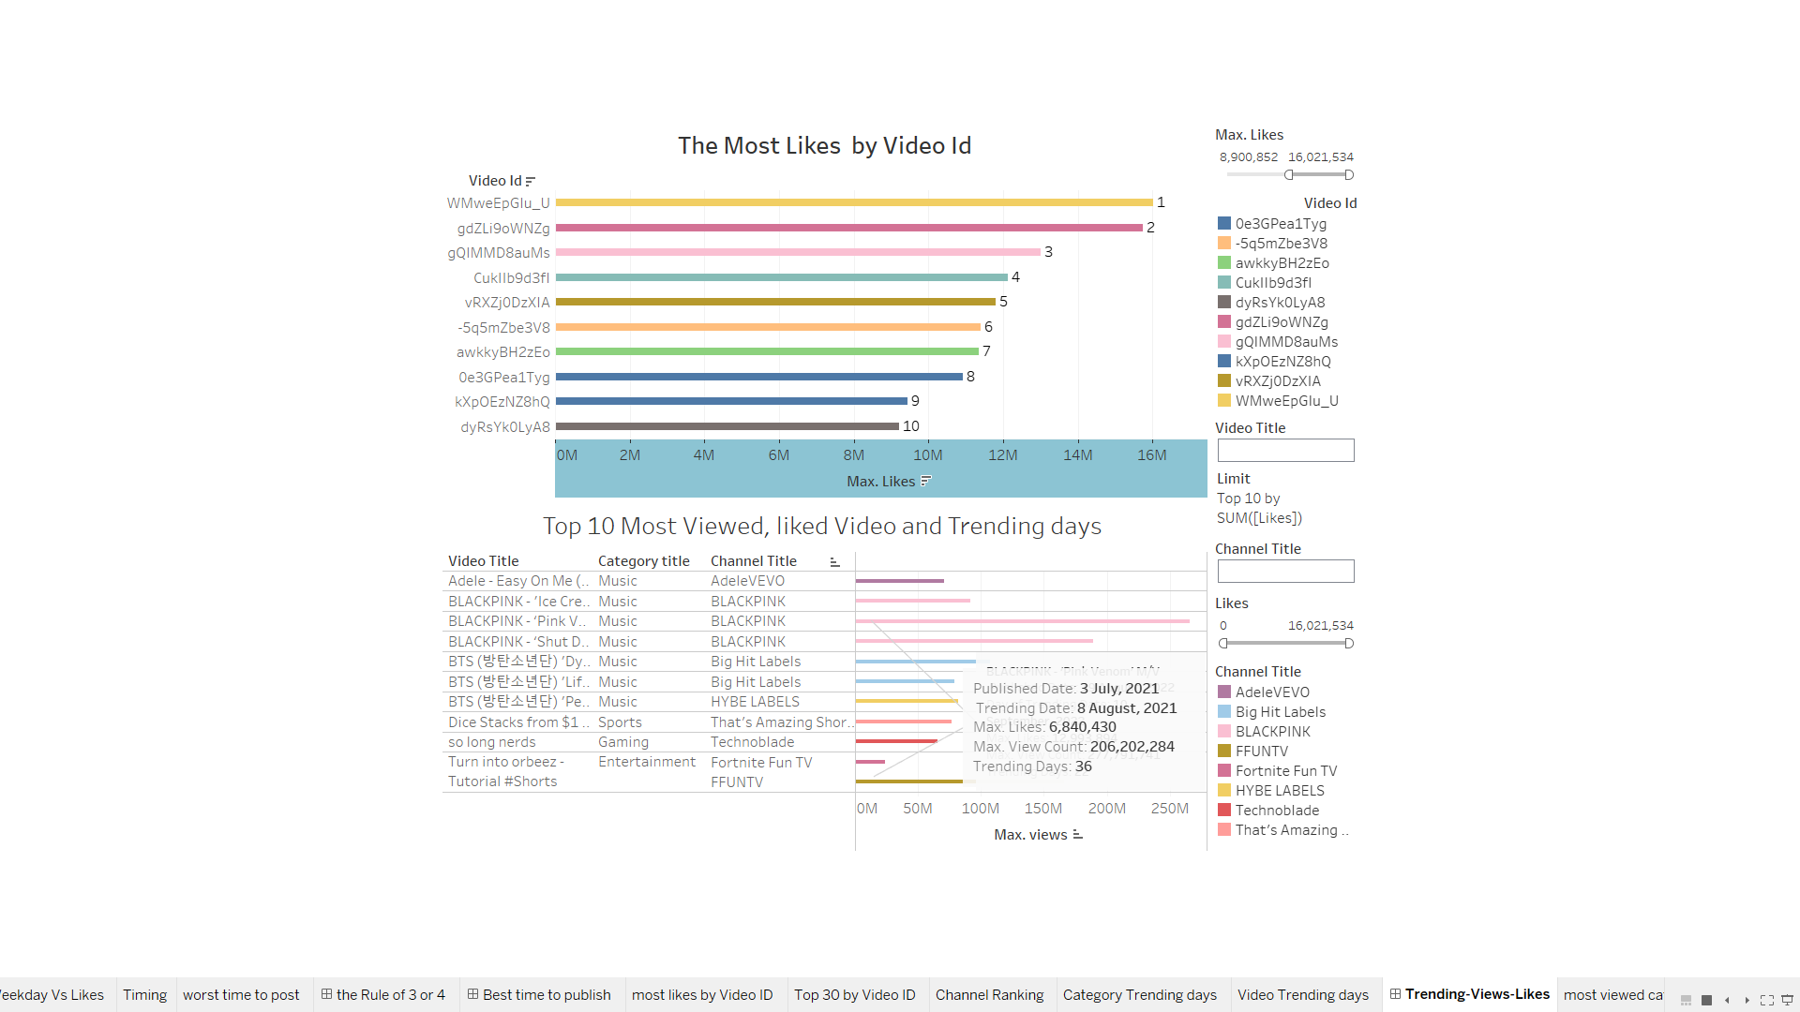
Findings
Conclusion to does it matter what time you post on YouTube?
* Yes in the short term: impact & optimize how many views within the first few hours.
* No in the long term, the most relevant video with high quality content will gain traction and last long time.
*Relevance is the biggest ranking factor on YouTube.

Slide 12
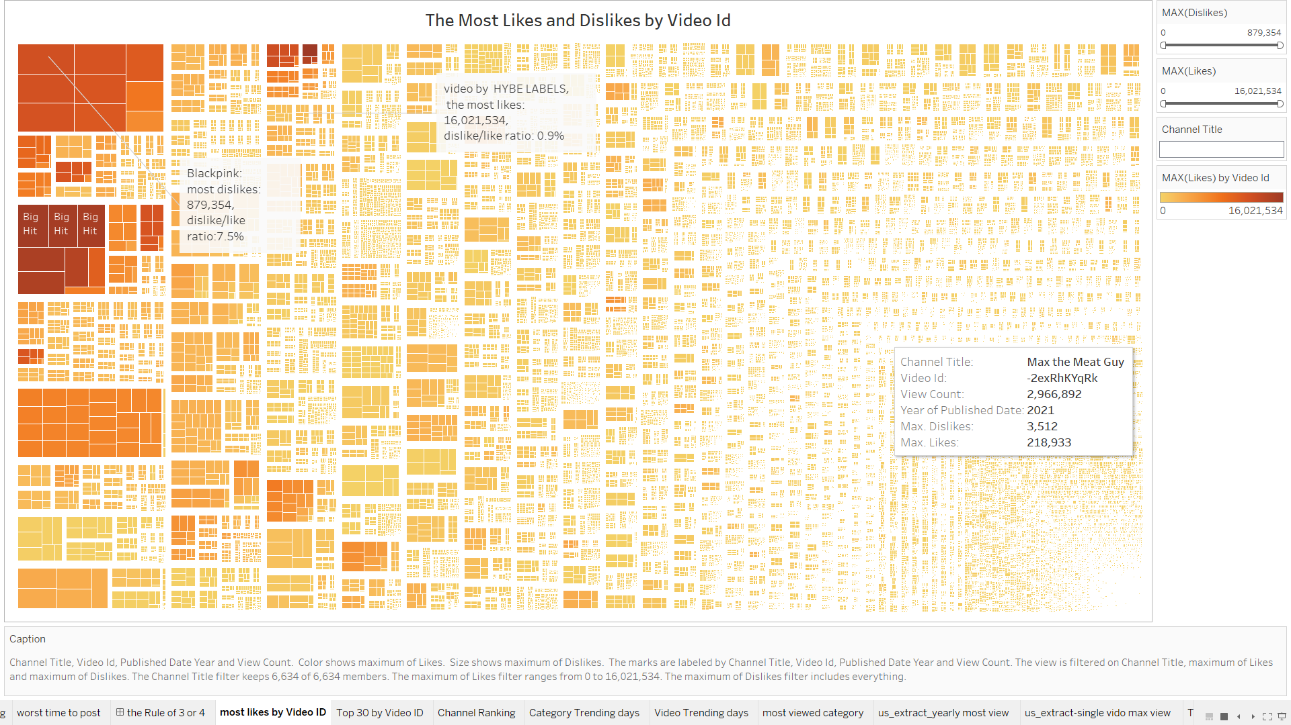
Findings: Why Blackpink: A New Peak Domination?
Treemap: Channels:6,634, Unique Video-Id: 30,985

Slide 13

Findings: Matthew effect on YouTube: a market with social influence
When utilizing performance rankings, a monopoly will be created for the most popular songs. Matthew effect - Wikipedia
Blackpink is the most-subscribed act on YouTube Music: 83M, Justin Bieber: 70.4M
List of most-subscribed YouTube Music artists - Wikipedia
Blackpink’s History-Making Accomplishments: A Timeline: BLACKPINK: Times the K-Pop Group Made History – Billboard

Slide 14

Findings: Matthew effect on YouTube: a market with social influence
Blackpink Branding and Marketing strategies:
Differentiation strategy: tough but elegant, beautiful yet talented
Focus on personal branding,
Be powerful influencers, 54M to 71M followers each
Collaborate with Dior, Channel;YSL, Celine and Bulgari to attract their users
Vision: Chart Domination in Worldwide
High-quality but scarce content
Consistently top the charts
Much larger production and marketing
budget
Aiming maximum visibility in South Korea
and international markets

Slide 15
Postmortem and Next Steps:
Lessons learned:
What Went Well:
Exame the process to find breakthrough points
Continuous learning

Slide 16
References:
Quantifying Social Influence in an Online Cultural Market: Quantifying Social Influence in an Online Cultural Market | PLOS ONE
Matthew Effect and experimental virtual market named MUSICLAB: Matthew effect - Wikipedia
The Rule of Three and Four: BCG - Rule of Three and Four: Become the Market Leader or Exit the Market! | Business Strategy Hub (bstrategyhub.com)
COMPETITIVE MARKETS AND THE RULE OF THREE: COMPETITIVE MARKETS AND THE RULE OF THREE - Ivey Business Journal
List of most-subscribed YouTube Music artists: List of most-subscribed YouTube Music artists - Wikipedia
Blackpink’s History-Making Accomplishments: A Timeline BLACKPINK: Times the K-Pop Group Made History – Billboard
E-Learning Market : E-Learning Market Trends 2022-2028, Global Forecast Report (gminsights.com)
Five Striking Personal Branding Lessons From K-Pop Sensation Blackpink: Five Striking Personal Branding Lessons From K-Pop Sensation Blackpink (forbes.com)
Benefits of Using YouTube For Your Online Education: Benefits of Using YouTube For Your Online Education | Articles Blog (asu.edu)

